Slide 1




Time Series Analysis of the distance between the Moon and the Earth. .
Swapnil Bhatta 965387

Slide 2

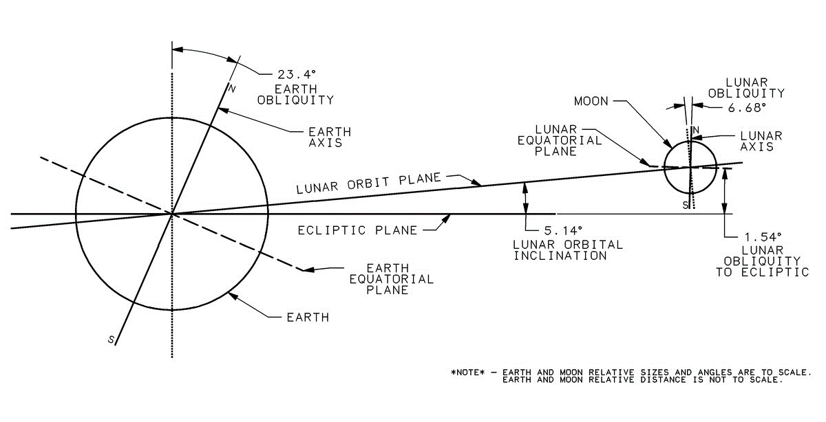
Orbital Mechanics and features of the Lunar Orbit.
The Moon is a natural satellite of Earth.
Prograde orbit.
Synchronous rotation.
Barycenter within the earth.
Apogee= 405,400 km, Perigee = 362,4200 km, Eccentricity= 0.0549006
Relevant periods: Sidereal = 27.32 days, Apsidal precession = 8.85 years.
Modelling the distance in between:
Data from NASA’s new horizons website. Lunar Laser Ranging (LLR) measures the distance using retroreflectors on the Moon with millimeter precision.
Frequency of data is daily, obtained data starts from January 1, 1951.
Data is given in Astronomical Units (1 AU = 1.496e+8 km).
Attempt to determine periods and establish a model that can predict distance (and possibly position) as a function of time. See if the exists a linearly significant trend.
Notes:
After consulting a variety of sources, you will need to narrow your topic. For example, the topic of internet safety is huge, but you could narrow that topic to include internet safety in regards to social media apps that teenagers are using heavily. A topic like that is more specific and will be relevant to your peers. Some questions to think about to help you narrow your topic:
What topics of the research interest me the most?
What topics of the research will interest my audience the most?
What topics will the audience find more engaging? Shocking? Inspiring?

Slide 3
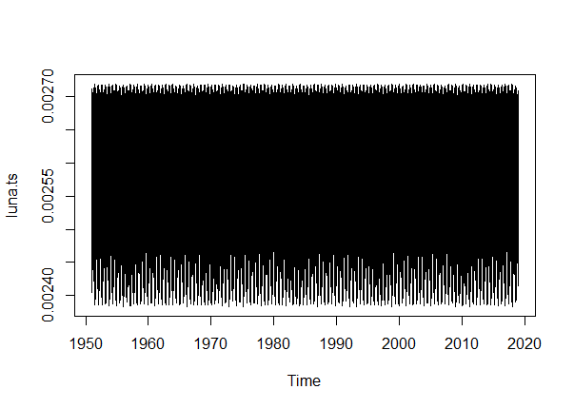
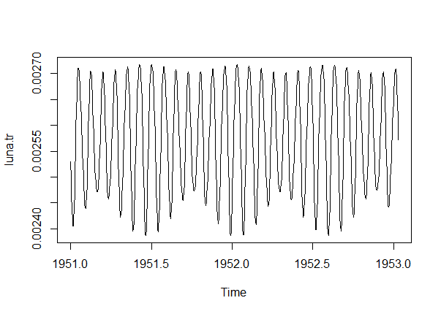
Modeling Method
The overall data ranging from 1951 to 2018 was essentially a cloud of points.
Truncated a segment of two years from the beginning of 1951 to the end of 1952.
Used external packages to analyse the spectrum, periodicity and dominant frequencies.
Ran multiple harmonics of the sine and cosine functions, checked for the fit.
Used a model to check for linear significance while avoiding pseudo replication.
Notes:
After consulting a variety of sources, you will need to narrow your topic. For example, the topic of internet safety is huge, but you could narrow that topic to include internet safety in regards to social media apps that teenagers are using heavily. A topic like that is more specific and will be relevant to your peers. Some questions to think about to help you narrow your topic:
What topics of the research interest me the most?
What topics of the research will interest my audience the most?
What topics will the audience find more engaging? Shocking? Inspiring?

Slide 4
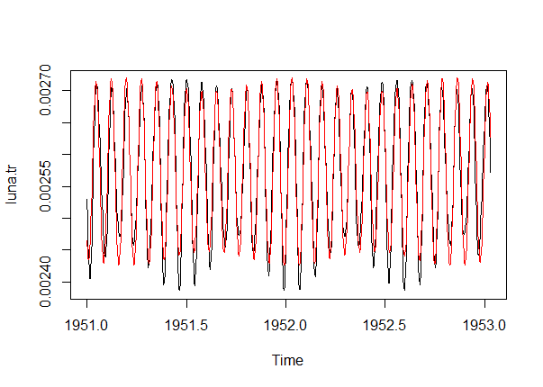
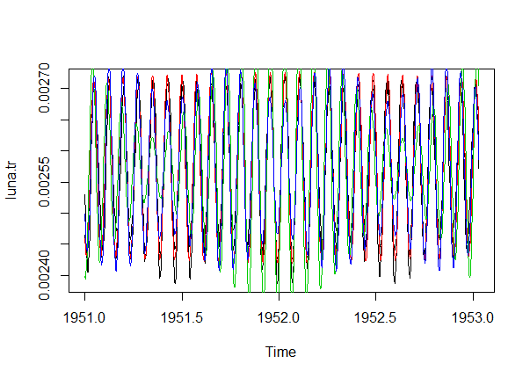
Quality through Visual inspection.
The harmonic function gave a significance range from 24π to 30π for both trig identities. No other significant values were detected.
This corresponds with the range of the moons sidereal orbit with a frequency of about 13.
The graph was fit with multiple harmonics using a for loop as seen in the second figure, with colour codes of the form (24+2(i)) where i is black, red, green and blue from 1 to 4.
The best fit obtained was for a double harmonic of 24π and 26π.
Notes:
After consulting a variety of sources, you will need to narrow your topic. For example, the topic of internet safety is huge, but you could narrow that topic to include internet safety in regards to social media apps that teenagers are using heavily. A topic like that is more specific and will be relevant to your peers. Some questions to think about to help you narrow your topic:
What topics of the research interest me the most?
What topics of the research will interest my audience the most?
What topics will the audience find more engaging? Shocking? Inspiring?

Slide 5
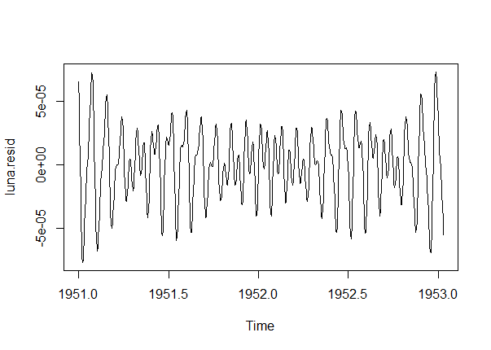
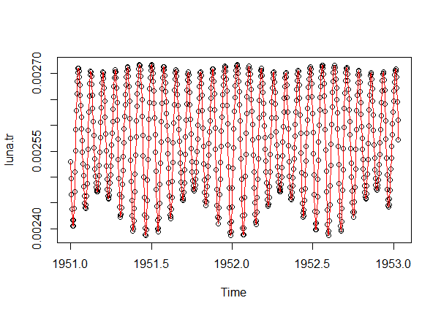
Quality analysis through residuals.
The model had a significant amount of residuals that were not random, an addition of a harmonic of a different significant frequency would help eliminate these.
Assuming the leftover residual to be random, an ARIMA fit gives an exact replica of the data itself.
Notes:
After consulting a variety of sources, you will need to narrow your topic. For example, the topic of internet safety is huge, but you could narrow that topic to include internet safety in regards to social media apps that teenagers are using heavily. A topic like that is more specific and will be relevant to your peers. Some questions to think about to help you narrow your topic:
What topics of the research interest me the most?
What topics of the research will interest my audience the most?
What topics will the audience find more engaging? Shocking? Inspiring?

Slide 6
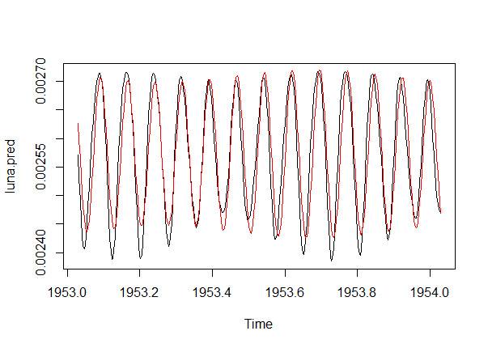
Prediction and conclusions.
Given the model is a harmonic fit of a periodic phenomena with no visible linear significance, any future prediction would essentially be a shifted version of the model as a function of the time of the predicted window.
A prediction was made for the year 1953, with a decent fit.
Notes:
After consulting a variety of sources, you will need to narrow your topic. For example, the topic of internet safety is huge, but you could narrow that topic to include internet safety in regards to social media apps that teenagers are using heavily. A topic like that is more specific and will be relevant to your peers. Some questions to think about to help you narrow your topic:
What topics of the research interest me the most?
What topics of the research will interest my audience the most?
What topics will the audience find more engaging? Shocking? Inspiring?

